Slide 1

Customer Behavior Analysis And Churn Prediction
COURSE TITLE
BUAN 6356.002
Group 4

Slide 2

Executive Summary
Customer retention and acquisition are particularly crucial in the telecommunications industry, which is highly competitive, and customers can simply migrate among different providers.
Telco is a telecommunications firm that serves about 7000 people in California with phone and internet services.

Slide 3
In the past few months, telco has noticed that few of its customers have already been churned. So, it wants to objectively assess the situation, understand its customers better and to launch the retention programs accordingly. We are going to help telco to address this issue.
We plan to use holistic approach to assist Telco. We will help it in understanding its customer, predicting their churn behavior, and suggesting on retaining most profitable ones.
As a result of our analysis, Telco:
Will understand its customer demographics better.
Will know its customer’s preferences.
Will identify which clients are the most profitable ones and how they churn.
Can predict customers’ future behavior using a prediction model and can try retaining them.
Can use product popularity data to promote the most popular products.
Can work on retention programs focused on specific customers based on suggestions provided.

Slide 4
Project motivation and background
Out of customer retention and acquisition, what type of strategy a company will choose depends on its unique needs and circumstances. Customer acquisition is often more expensive than their retention for a middle-sized company.
So, telco is more interested in customer retention strategy.
It needs help with analyzing its customers and their churn behavior.

Slide 5
To help Telco achieve its objective, we will do the following:
Understand its customers in terms of
Age
Gender
Whether they have Partner/Not
Whether they have Dependent/Not
What kind of contract (long-term/short term) do most customers prefer?
What type of products/services are popular among customers?
What type of product/services are least preferred by the customers?
What kind of customers are key revenue generators and their churn behavior?
Use prediction models, such as the Decision tree and logistic regression model, and select the model with the highest accuracy to predict whether the customer is likely to churn or not.
Give suggestions based on the insights we got.
Objective

Slide 6
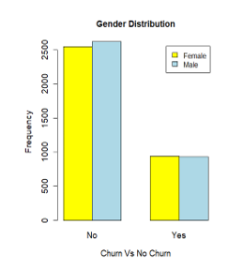
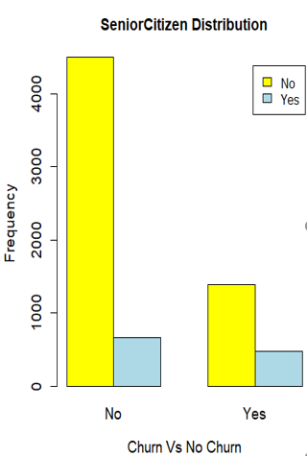
Data Description
50.5% customers are male.
84% customers are young.

Slide 7
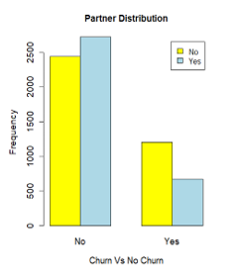
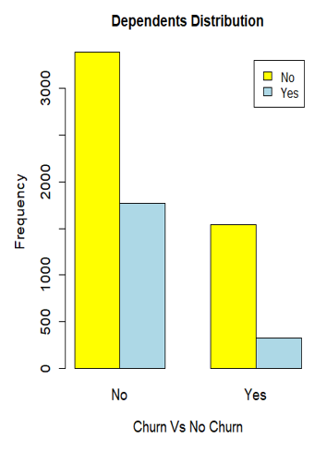
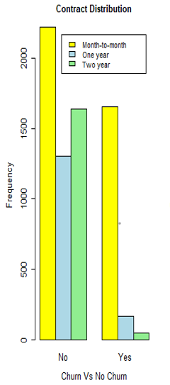
52% customers don’t have partners
70% of the customers don’t have dependents
45% of the customers
have long-term contracts
90% of the customers use phone service, 78% use internet service and 70% of them use both phone and internet service. Fiber optic is preferred internet service option.
66% to 70% of the customers don’t prefer online security, online backup, device protection, or tech support.

Slide 8
BI Models
We will run two machine learning models for client churn prediction (i.e., decision tree and logistic regression model). After comparing their performance, we will select the best between the two to predict the customer churn.
Decision Tree: Decision trees are popular machine learning models used for classification and regression. As the name suggests, the model returns output in a tree-like structure with a series of nodes and leaves. Each node represents a test on input, and each leave is a class assignment. Decision trees are so popular because they can handle missing values and outliers and provide easily understandable rules.
Logistic Regression model: A logistic regression model is a powerful machine learning model that extends the idea of linear regression to predict the binary outcome based on historical data.

Slide 9

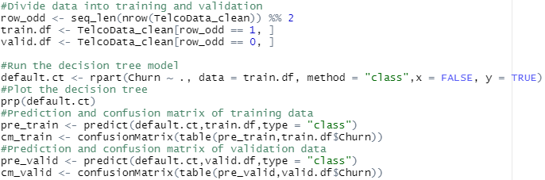
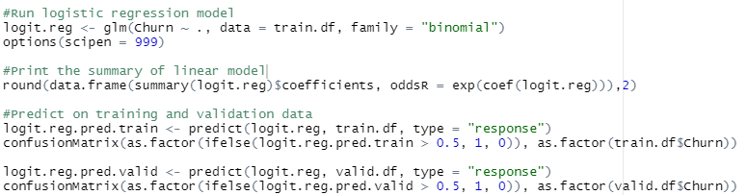
BI Models
R Code Used:
Decision Tree:
Logistic regression model:

Slide 10
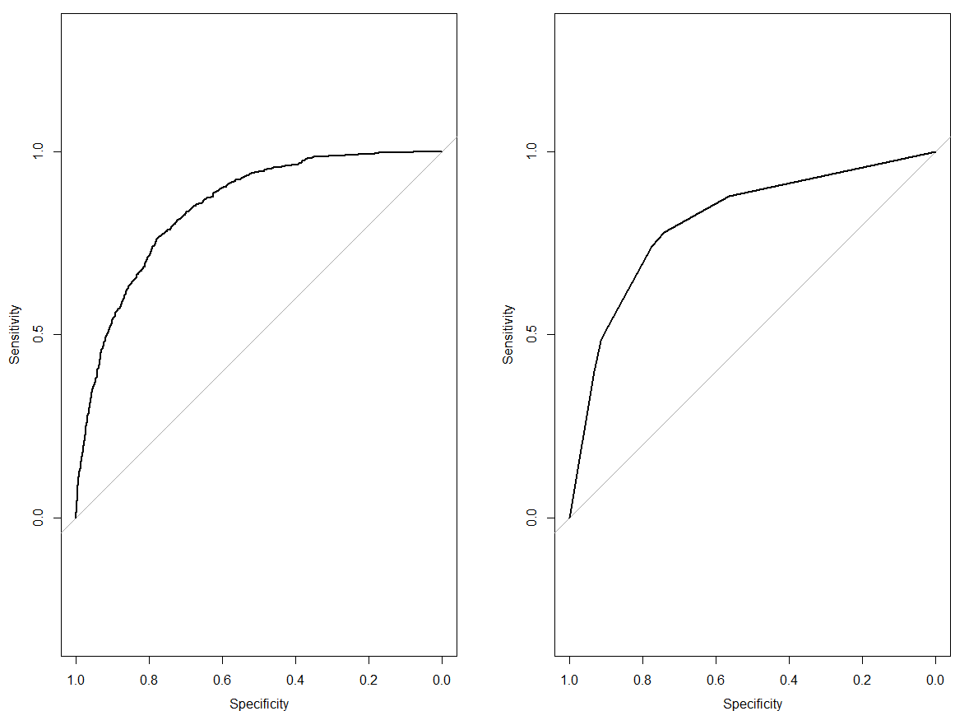
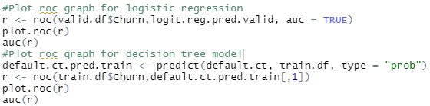
Models Comparison and selection
ROC curve:
The receiver operating characteristic curve is used to visualize and evaluate the performance of classification models. ROC is a probability curve, and AUC (Area under the curve) represents the degree or measure of separability. It tells how much the model is capable of distinguishing between classes. Higher the AUC, the better the
model performance.
ROC – Logistic regression
ROC -Decision Tree
ROC Plot code for both models:
AUC – Logistic Regression: 0.8465
AUC – Decision Tree: .81
As AUC for logistic regression model is better, so we will use logistic regression model to predict customer churn behavior.

Slide 11
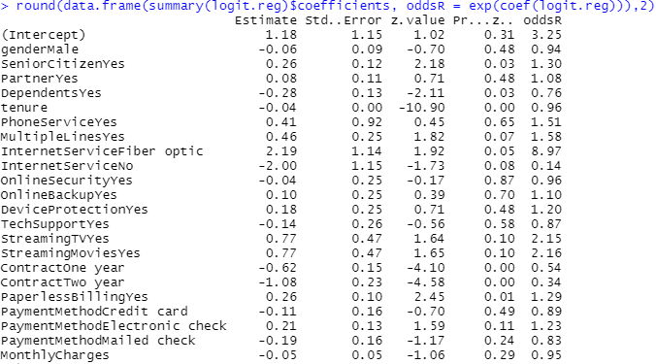
Logistic model output
Important Interpretations:
Senior citizens are 1.3 times more likely to churn as compared to young.
Male customers are slightly less likely to churn as compared to female customers.
Clients using fiber-optic service are approximately nine times as likely to churn as a client using DSL internet service. We must figure out the reason for such a high odds ratio.
Customers using streaming tv and streaming movies services are twice as likely to churn as customers using no such offerings.

Slide 12
Majority of customers are young and are less likely to churn compared to the senior ones.
Male and female customers are approximately equal, and males are slightly less likely to churn.
Customers with and without partners are equal in number, and both are equally likely to churn.
Majority of the customers don’t have dependents, and they are more likely to churn as compared to the customers with dependents.
More than fifty percent of customers are on a month-to-month contract, and they are more likely to churn as compared to long-term ones.
Phone service and fiber optic internet service are the most popular services used by the consumers.
Online security, online backup, device protection, and tech support are the least used services by the customers.
Customers with short-term contracts use fiber-optic services more than DSL, and they are more likely to churn. At the same time, clients on the long-term contracts use DSL more than fiber-optic services, and they are less likely to churn. It explains the high odds ratio of fiber-optic w.r.t DSL.
In total, there are approximately 1600 major revenue generating customers on month-to-month contract with Telco, out of those 1300 are already with telco for one year or more.
(Note: Major revenue generating customers use phone service + internet service + one or more Miscellaneous services. Miscellaneous services include multiple lines, online security, online backup, device protection, tech support, streaming movies, and streaming TV)
Findings

